Slide 1
Crime predictor
(Boston City area)
Sai KS Thar
CSC521
Capstone Project Presentation
CSC 521 Advisor: Dr. Komalpreet Kaur
December 14th, 2021

Slide 2
Overview
Student Objectives
Problem Specification
Solution Process & Design
Proposed and Final UI Mockups
Tools List
Time Schedule
Grading Scheme
Deliverables
References

Slide 3
Student Objectives
Demonstrate knowledge learnt in Machine Learning & related courses
Gain skills and experience in Machine Learning applications, i.e., Data Pre-processing, Feature selection, Tuning the model etc.
Develop problem solving skills
Get more experience with using Python libraries
Enhance Python programming skills

Slide 4
Problem specification
Crimes are one of the biggest problem for every civilization in the world and most people hate crimes.
People are likely to use modern technologies to avoid high-rate crime location/area, similar to using weather forecast apps.
Main idea of this project is to determine the chances of high potential threats in individual time-frame, days of week within the Boston City Area.

Slide 5
Solution process & design – Requirements Collection &Analysis
Project will have two user modes., General Public and Privilege modes.
General public cannot have ability to update the train dataset whereas Privilege can update the train dataset(dataset is sensitive and only be allow from Boston Police dept. data website). Aside of that, both have the same functions. U According to available datasets, differences and updated solution design, the privilege mode is cancelled.
The required information(input) is passed through the GUI and the trained model will predict the prediction.
If the required information(input) is invalid, user will be notified.
Otherwise, the process will go on.
The predicted outcome will be show up.

Slide 6
Solution process & design – Requirements Collection &Analysis
Dataset verification: accurate, reliable, well-organized and are based on real-world crime incident reports approved and published by Boston Police Dept.
This ML project may also be compatible with future datasets from Boston Police Dept. website. This does not guarantee since they made minor changes in recent datasets.
13 initial features with over 250 different crimes, 12 Districts, 800 reporting areas.
For ML algorithms, I would like to try different algorithms for optimal outcomes. i.e., ANN, SVM, Random Forecast, CNN and so on. I’ve tried most algorithms that gives the satisfactory results, and finally chose Decision Tree Regressor for the optimal accuracy results.

Slide 7
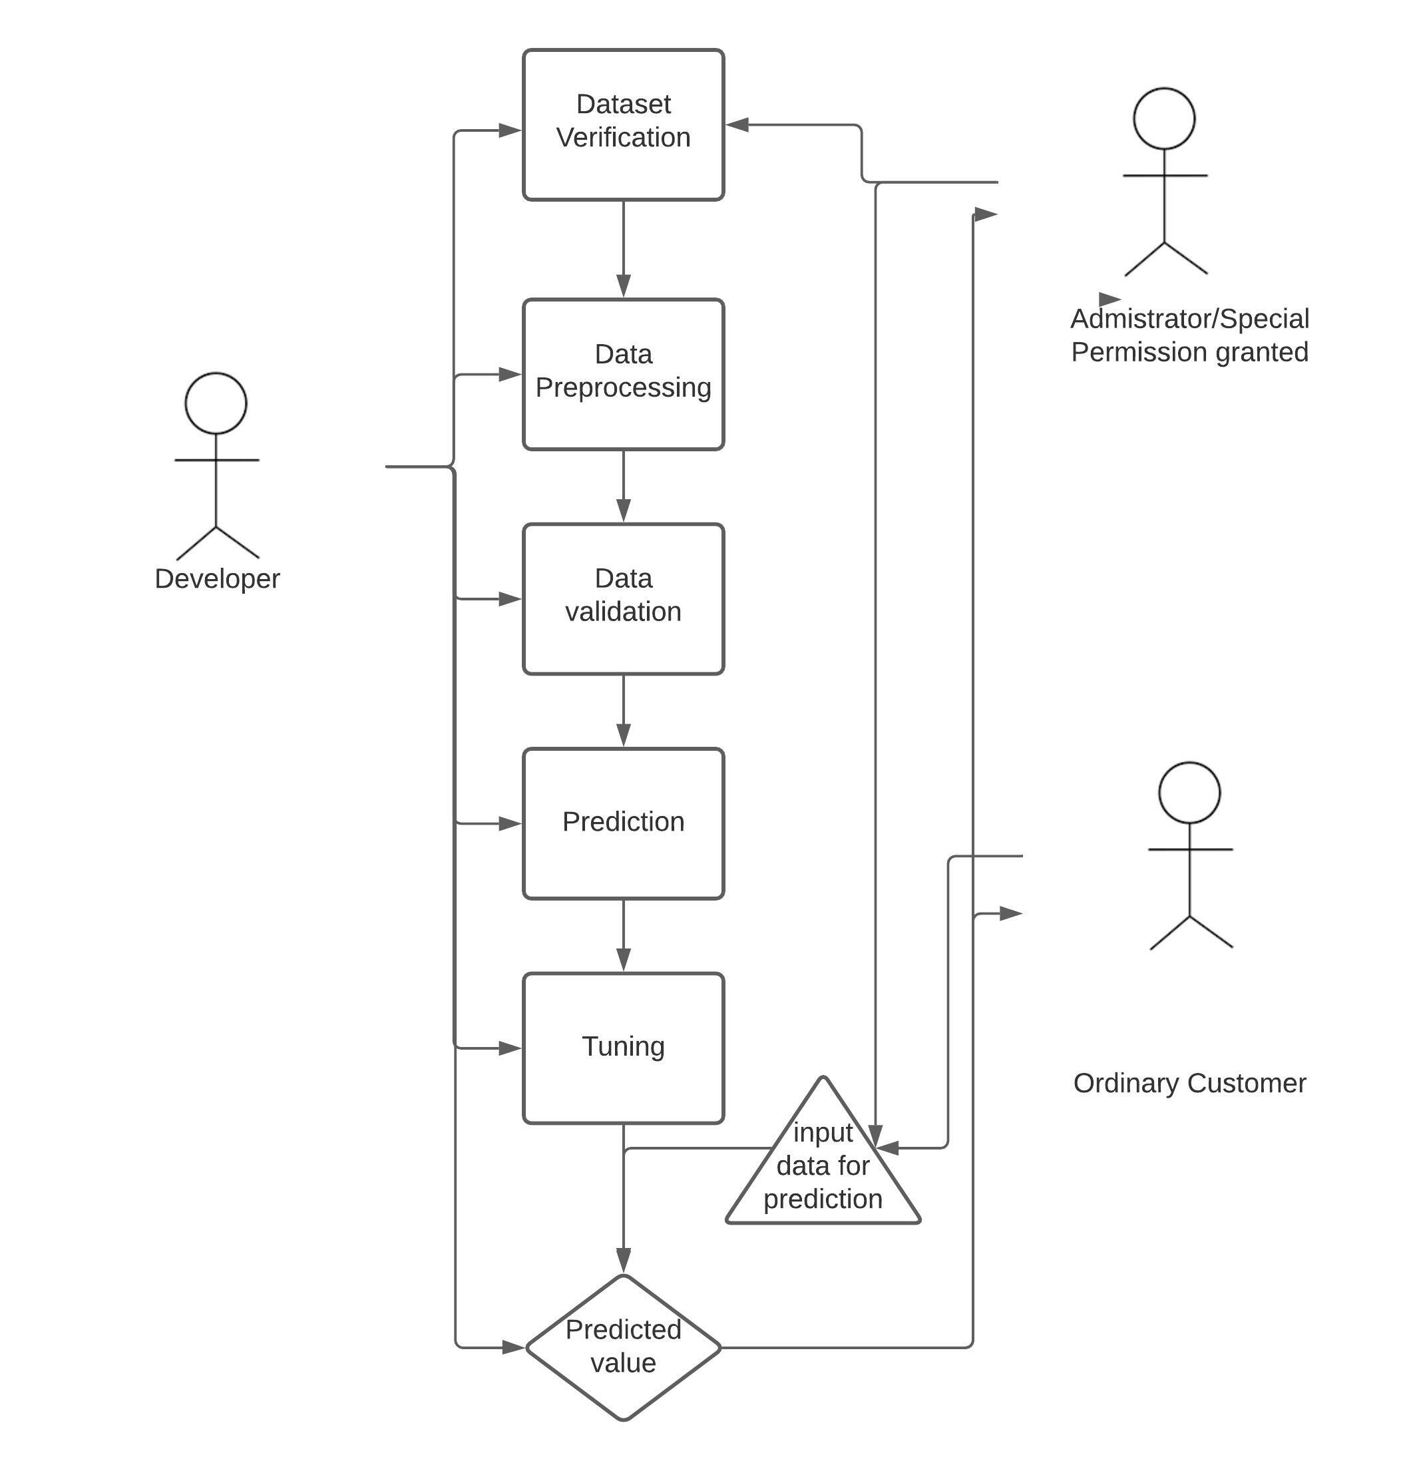
Solution process & design(proposed)
High level Design
Developer are the only responsible for the entire ML process.
Privileged Users can update the datasets
Normal users cannot update the datasets

Slide 8
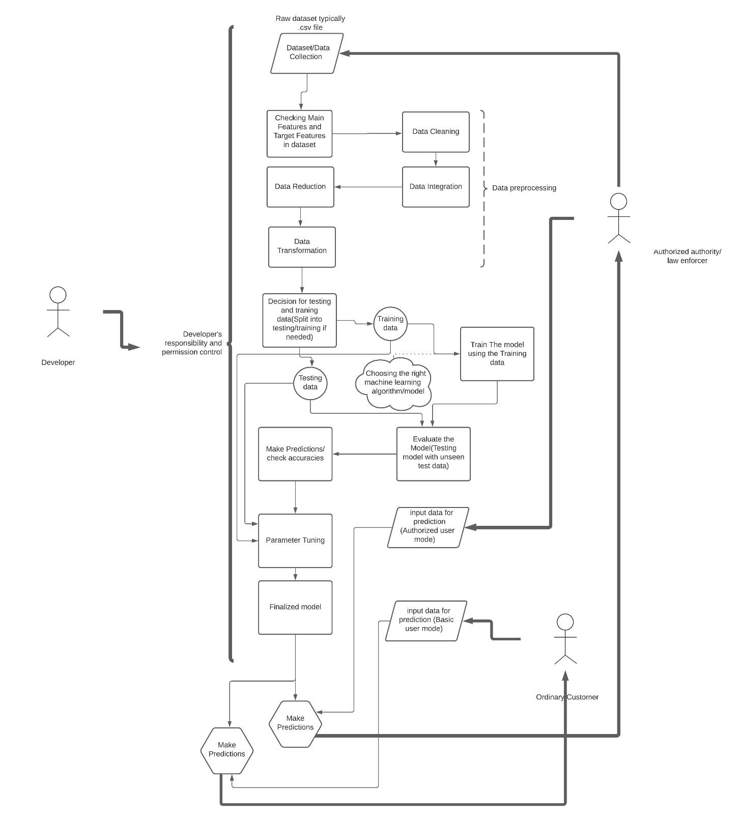
Solution process & design(Proposed) (cont.)
Low Level Design
Data verification
Data Pre-processing
Feature selection
Train-test split
Train data using appropriate algorithms
Check output and parameter tuning
Final delivery for predicted value

Slide 9

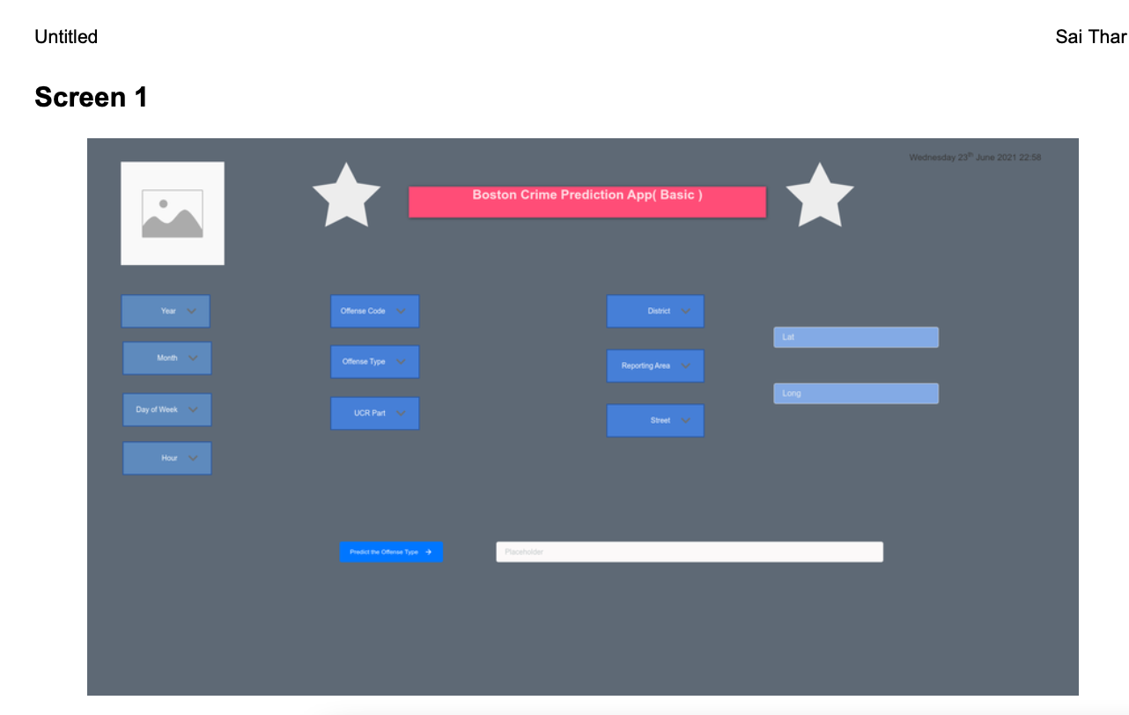

UI mockups (Proposed)
UI for General Public

Slide 10
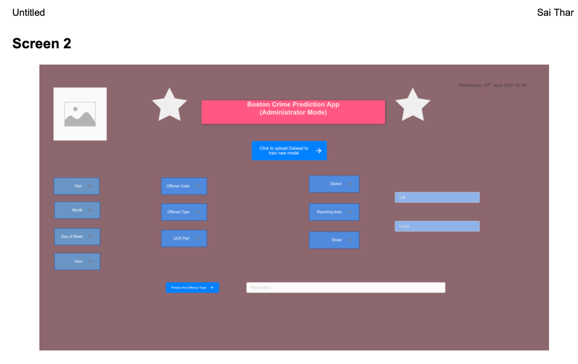
UI mockups(cont.) (Proposed) This UI for privileged users is not implemented
UI for Privileged Users

Slide 11
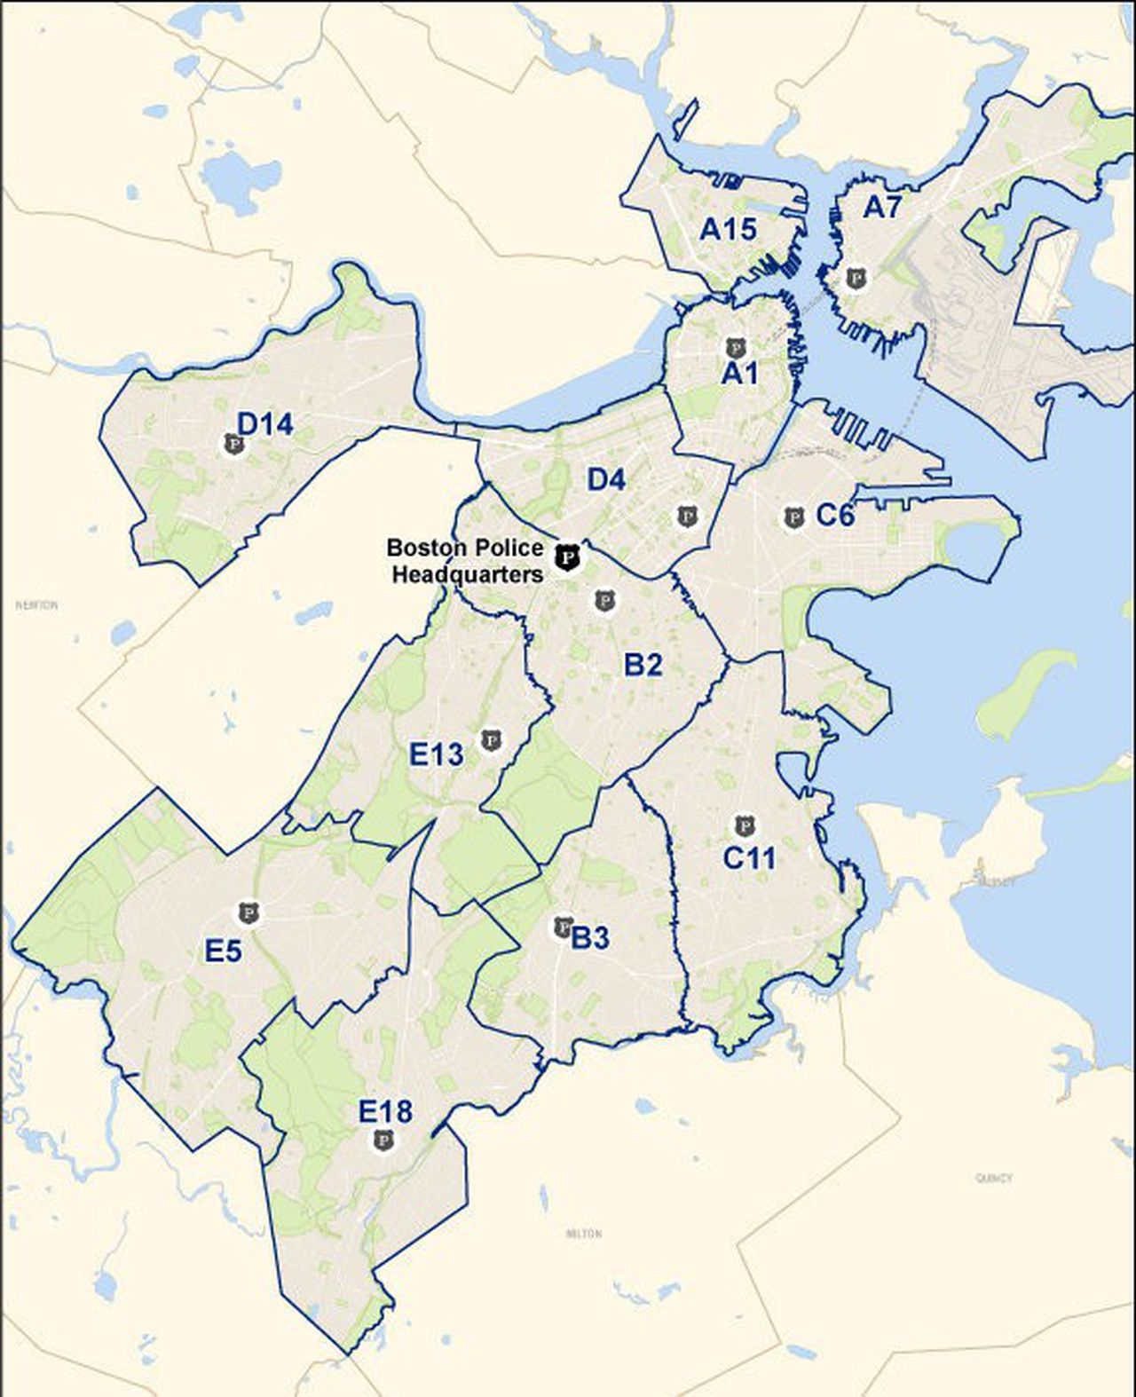

UI mockups(cont.)
UI mockups for both users are very general idea only and final deliverable GUI may be differed from the initial 520 Presentation.
Output will be based on the actual map of Boston city based on 12 unique districts.

Slide 12

Software
Python 3.8 (Programming Language platform)
Spyder 5.05 ( IDE)
Anaconda Navigator (Python Environment & library management)
TensorFlow, SciPy etc. related Python Libraries
Git, GitHub for source control
Hardware
A relevant PC with Big Big GPU
Trello for project management
Tools list

Slide 13
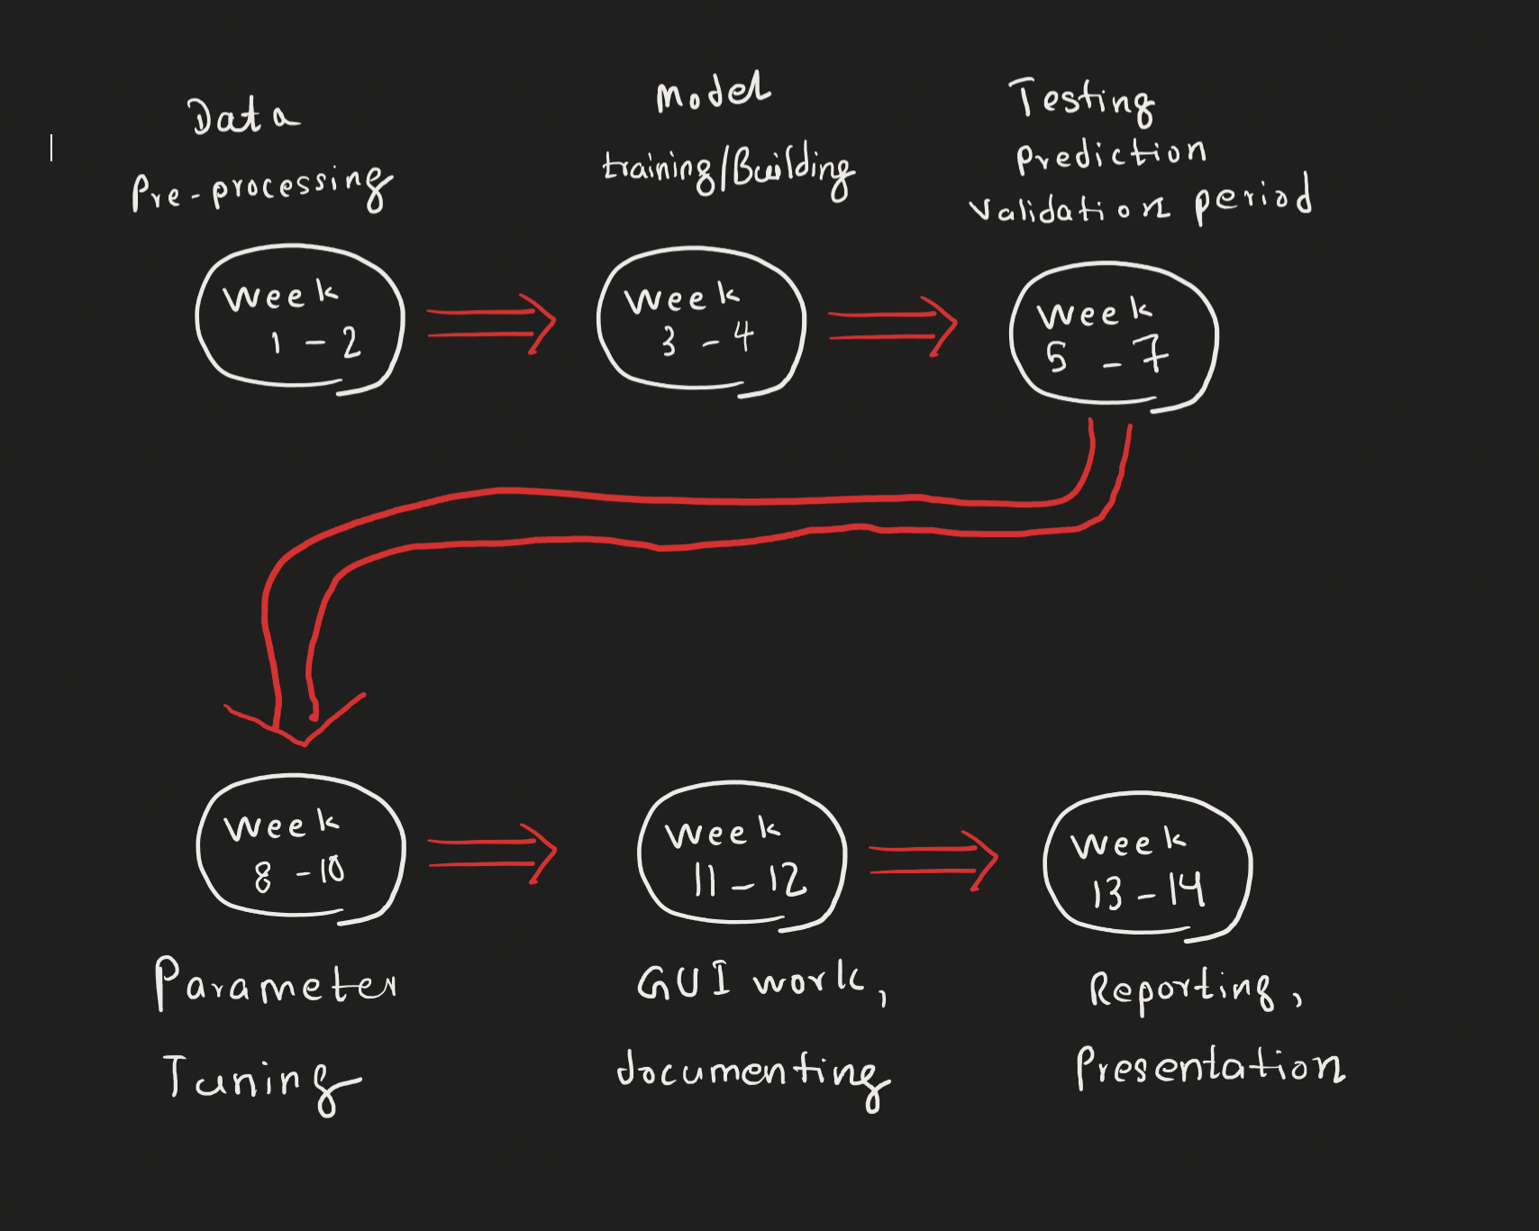
Time schedule

Slide 14
Benchmark specification
Benchmark 1: Data Preprocessing
Benchmark 2: Model Training/building
Benchmark 3: Testing, Prediction & validation
Benchmark 4: Parameter Tuning
Benchmark 5: GUI Works

Slide 15
Grading scheme
Benchmark Specification | Grade Percentage
Benchmark 1: Data Preprocessing | 20%
Benchmark 2: Model Training/building | 20%
Benchmark 3: Testing, Prediction & validation | 20%
Benchmark 4: Parameter Tuning | 15%
Benchmark 5: GUI Works | 15%
Presentation | 10%

Slide 16
Deliverables
original proposal and presentation file(s) (from CSC 520)
amendments to the proposal (approved by the project supervisor)
system architecture diagram(s) / Flow Charts etc.
related working source code
documentation of project functionality (test results, screenshots, video capture of project execution, etc.)
sample output (screen shots and/or reports)
executables
presentation documents (used to support the presentation of the completed CSC 521 project), including
presentation file(s)
project journal: a narrative of the progress of the project, in clear, concise English, including any problems encountered and how said problems were addressed
project postmortem: a summary of what was learned from the project
Project Journal
Lists of incomplete proposals and reasons documents
User manual

Slide 17
REFERENCES
https://data.boston.gov/dataset/crime-incident-reports-august-2015-to-date-source-new-system
https://www.jeremyjordan.me/ml-projects-guide/
https://www.kdnuggets.com/2018/11/machine-learning-classification-dataset-based-pictorial.html
https://www.tensorflow.org/learn
https://docs.anaconda.com/anaconda/navigator/index.html

Slide 18


